Slide 1
Final Year Project - Quartermaster
By Ethan Holohan – C20322553
Supervisor – Colette Kirwan

Slide 2
Project Background
Airsoft is a Growing hobby similar to paintball
Rules can get complicated
Player safety is a big concern

Slide 3
Goals of Quartermaster
Goals of Quartermaster are:
To Enhance players understanding of the game
Encourage Team play
Ensure Players can always communicate with a marshal in emergency
Provide a way for players to track the game and their stats

Slide 4


Existing Solutions
Ares Alpha
Focused on longer 24hr+ games
No help with rules
Airsoft Force Tracking
Focused on shorter <1hr games
No safety features

Slide 5




Technologies Researched
Kotlin
Firebase
Jetpack Compose
Mockk
Open street Maps

Slide 6
Requirements Gathering
Requirements gathering important in creating a good app
Requirements gathered through survey & interview
End requirements where:
Players wanted to be able to track team mates
Players wanted app to be easy to setup
Marshals Needed safety features

Slide 7
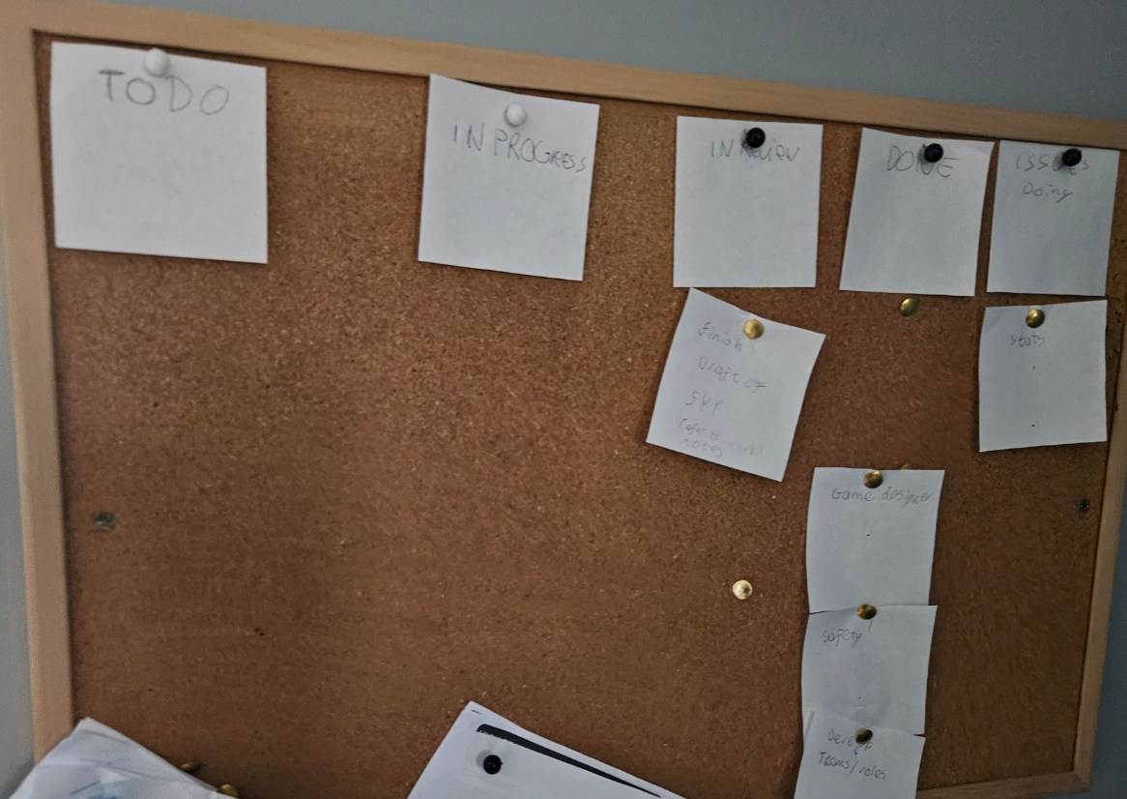
Development Methodology
Chosen Methodology was agile Kanban
Kanban was chosen as it helps
with workflow and visualisation of work.
Will help with time management

Slide 8
Overview of System
2 tier architecture
Front End
Native android App
Kotlin
Jetpack Compose
Back End
Firebase Real-time Database
(NoSql)
Firebase Cloud Functions
Firebase Cloud Messaging

Slide 9
UI Design
UI Designed to be simple to use
Designed to be minimalist with little noise
UI went through multiple changes during design
Heuristic evaluation was carried out to evaluate designed UI

Slide 10
Project Development
Project was developed on android studio
GitHub was used to manage versions and prevent dataloss

Slide 11
Firebase

Slide 12
Development of Native Application

Slide 13
Testing

Slide 14
White Box testing

Slide 15
Black Box Testing

Slide 16
Evaluation

Slide 17
Demo

Slide 18
Issues Encountered

Slide 19
Future Work

